Slide 1
Project Title: FitSense
Code Busters | Vibeaithon 2025
AI that senses your fitness..!

Slide 2
Problem Statement
• In today’s fast-paced lifestyle, most people lack personalized fitness guidance and proper workout form correction.
• Many rely on generic online tutorials that don’t adapt to their posture, repetitions, or body type.
•Improper posture and overtraining lead to injuries, especially for beginners without trainers.
•There’s a growing need for an affordable, intelligent, and interactive digital fitness coach accessible to everyone, anywhere

Slide 3
Solution Overview
FitSense is an AI-powered personal fitness assistant that analyzes movements in real-time, detects posture errors, counts repetitions, estimates body ratio, and recommends diet and workout plans — all in one platform.
Key Features:
🏋️ Real-time Repetition Counter using pose estimation
🧍 Posture Correction with voice and visual feedback
📏 Body Ratio Detection & Personalized Diet Recommendation
💬 AI Chatbot trained on fitness and nutrition data
Technology Stack:
Streamlit | MediaPipe | OpenCV | NumPy | Pandas | Sentence Transformers | scikit-learn | Pyttsx3
Uniqueness:
• Combines computer vision + NLP + voice AI
• Provides instant visual and audio guidance, like a human trainer.
• runs on lightweight models

Slide 4
Desirability
Target Users:
• Fitness enthusiasts, beginners, and remote workers
• People seeking injury-free home workouts
• Health-conscious individuals without access to gyms/trainers
User Pain Points Solved:
• No need for physical trainers
• Instant correction feedback
• Personalized fitness and diet recommendations
Validation:
Early testers found FitSense accurate, interactive, and motivating, with 90% reporting improved form and discipline during workouts.

Slide 5
Feasibility
Tools and Tech stack:
• Streamlit for interactive UI
• MediaPipe & OpenCV for pose estimation
• SentenceTransformer for chatbot intelligence
• Pyttsx3 for voice assistant
• Pandas + scikit-learn for data handling
Development architecture:
• Frontend: Streamlit Web App
• Backend: Python CV models for posture detection
• NLP Layer: Fitness Chatbot using SentenceTransformer embeddings
Feasibility Proof:
• Fully functional prototype already built
• Runs on standard laptops (no GPU dependency)

Slide 6
Viability
Revenue / Impact Model:
Freemium Model: Free basic features + Premium for AI trainer insights
Partnerships with gyms, fitness apps, and diet platforms
Potential integration with wearables and smartphone sensors
Market Opportunity:
Global digital fitness market size: $20+ billion
High growth in AI-based health tech and home workout sectors
Scalability:
Can expand into mobile apps and AR fitness tracking
Minimal cost and high accessibility make it globally scalable

Slide 7
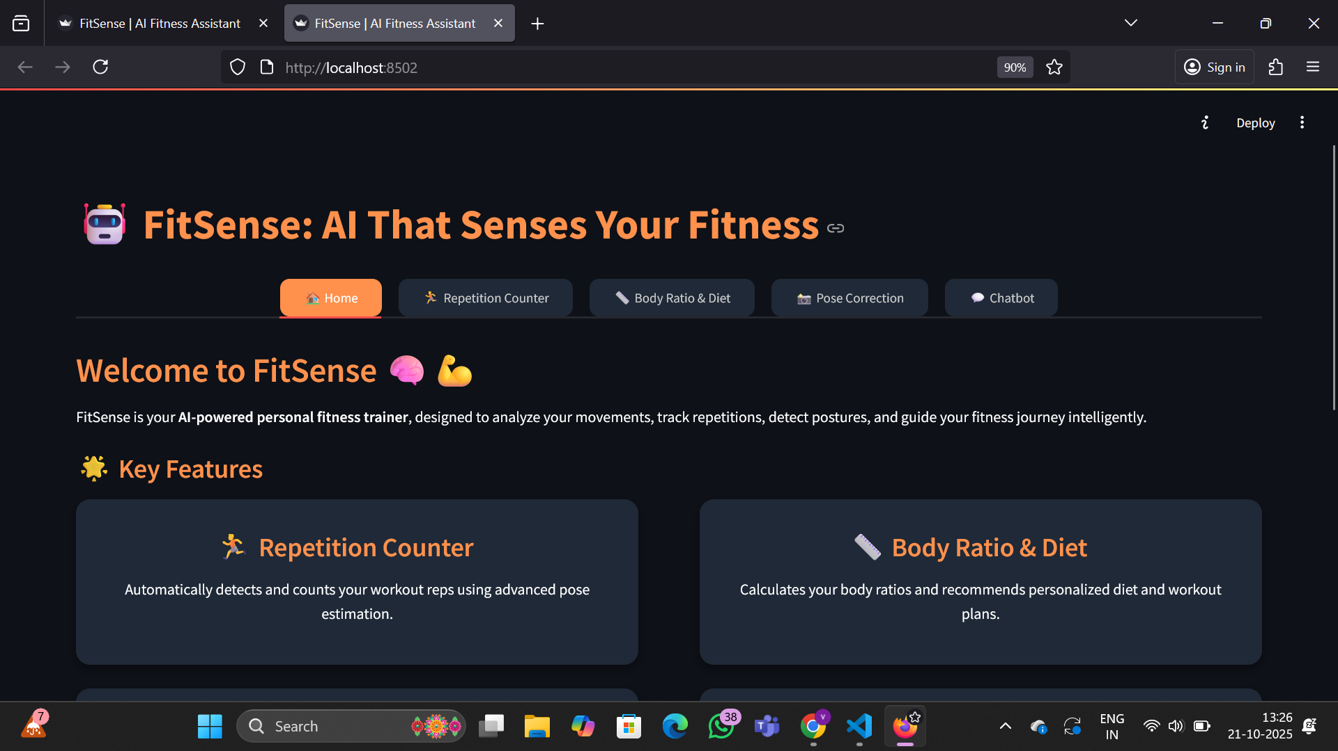
Prototype / Demo home page

Slide 8
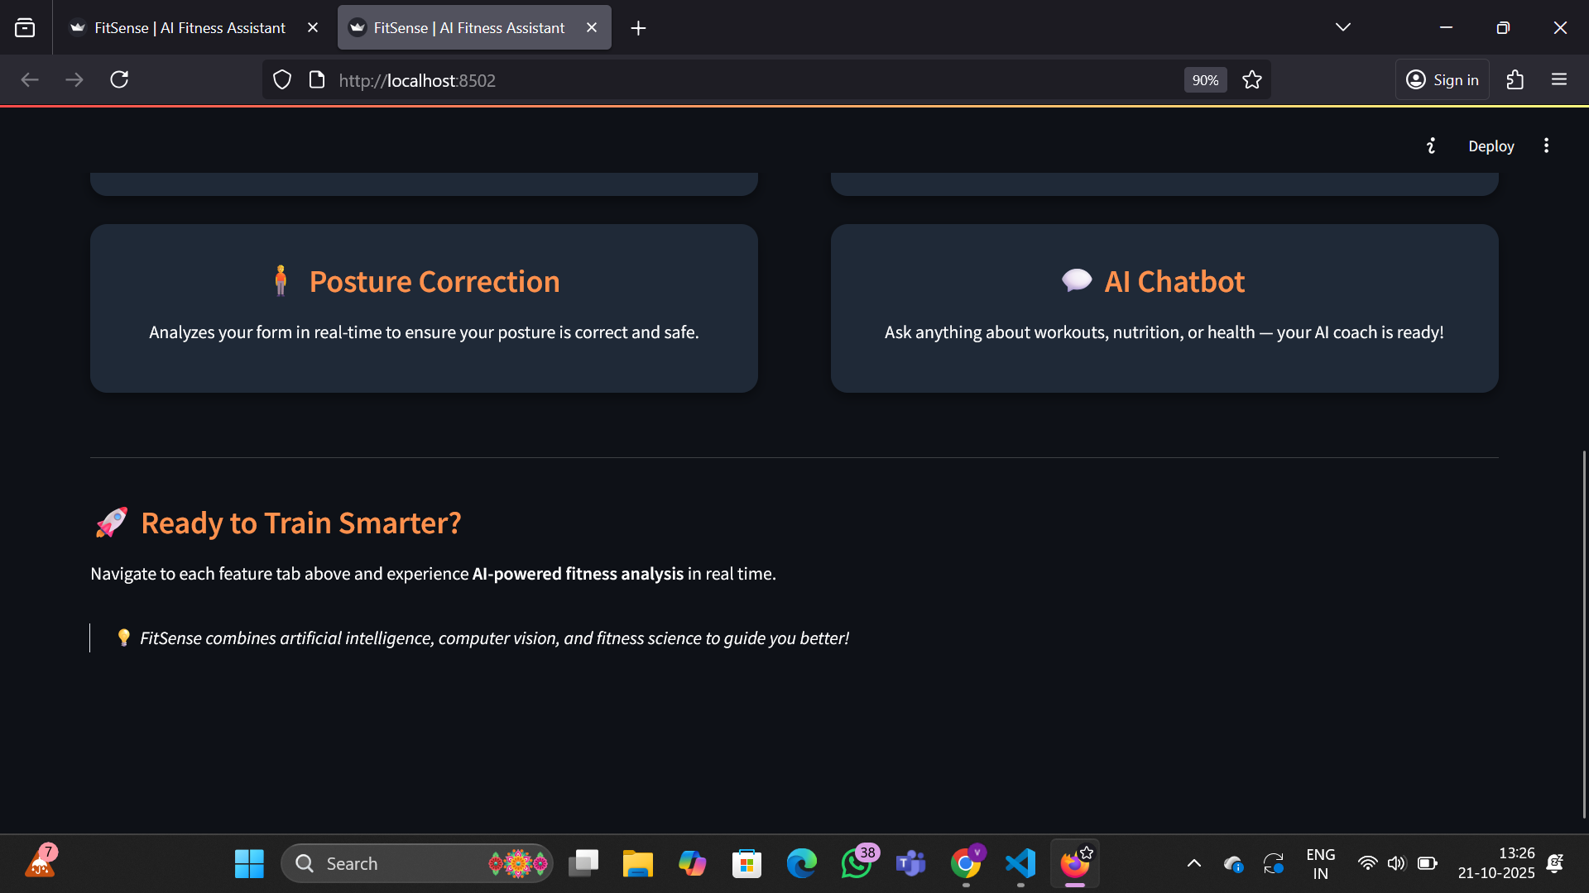

Slide 9
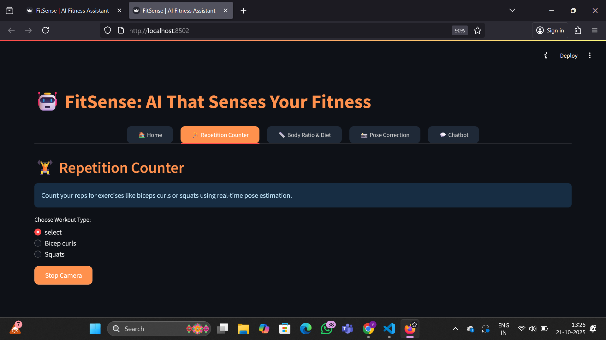
Repetition counter

Slide 10
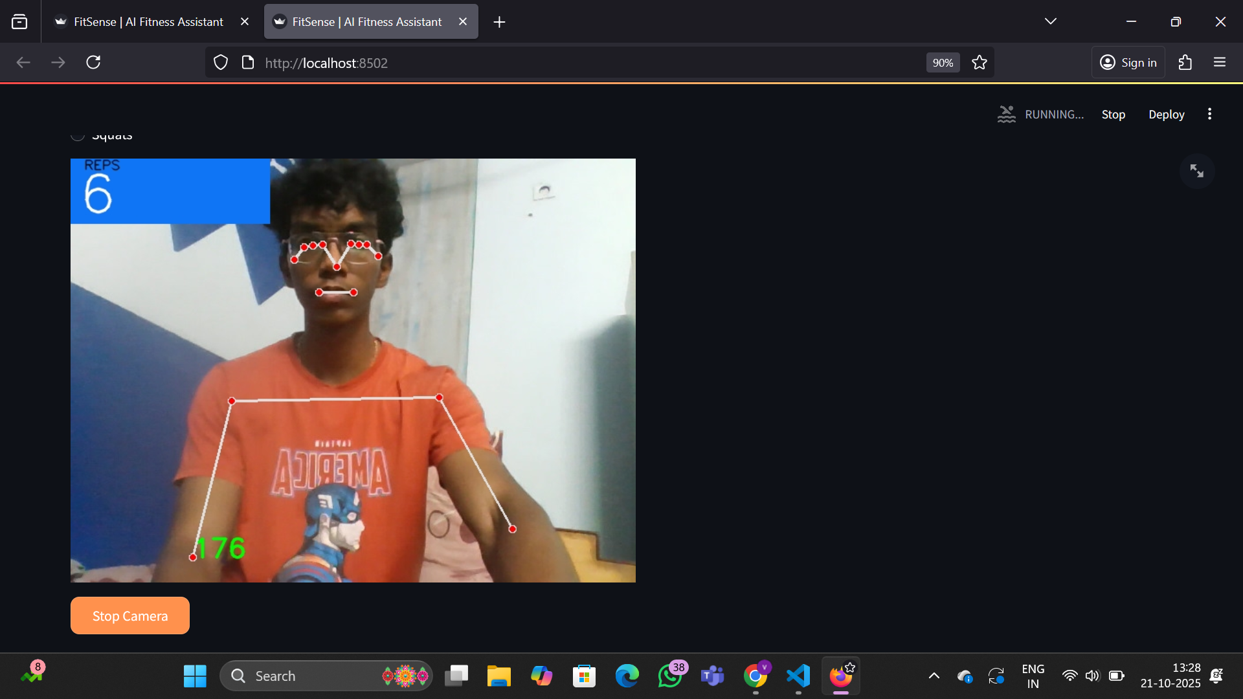
Counts the reps lively by angle computations.

Slide 11
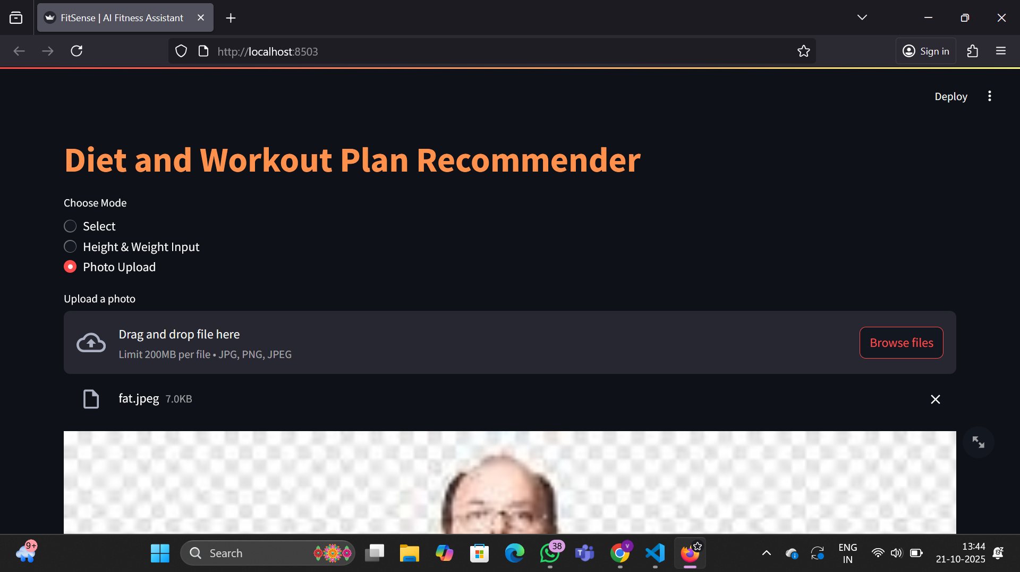
Diet and workout plan recommender

Slide 12
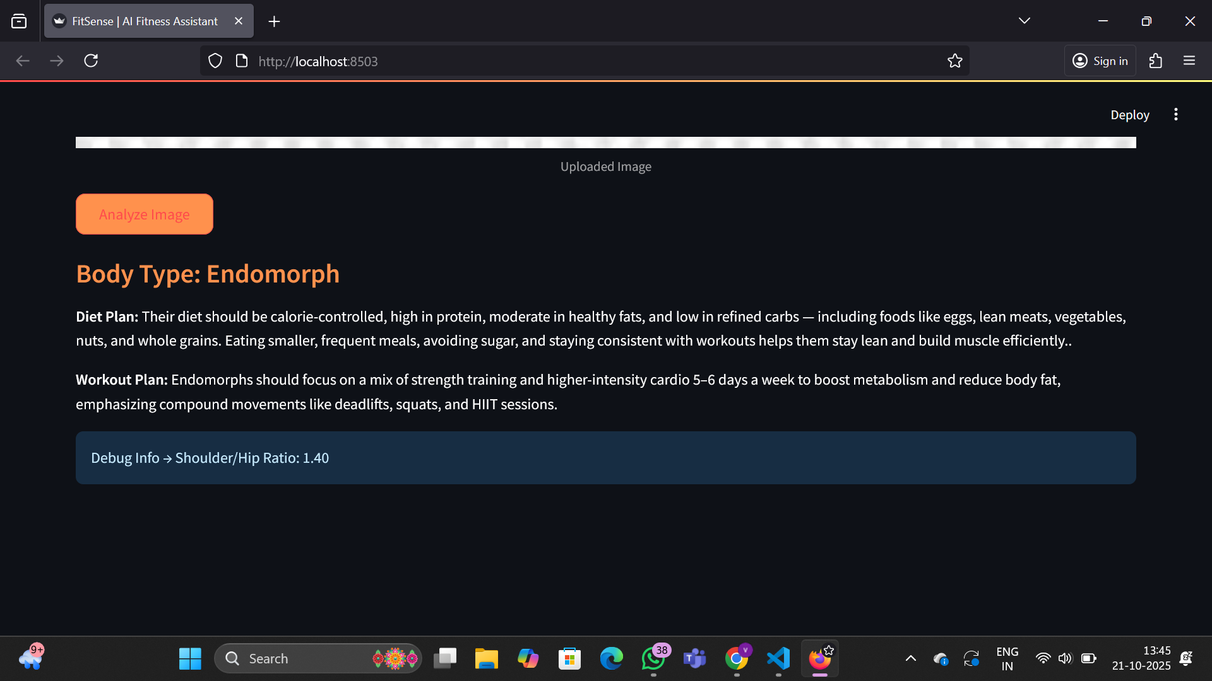
After clicking “analyze image” it provides the body type of the person, diet and workout plan and shoulder/hip ratio of that person.

Slide 13
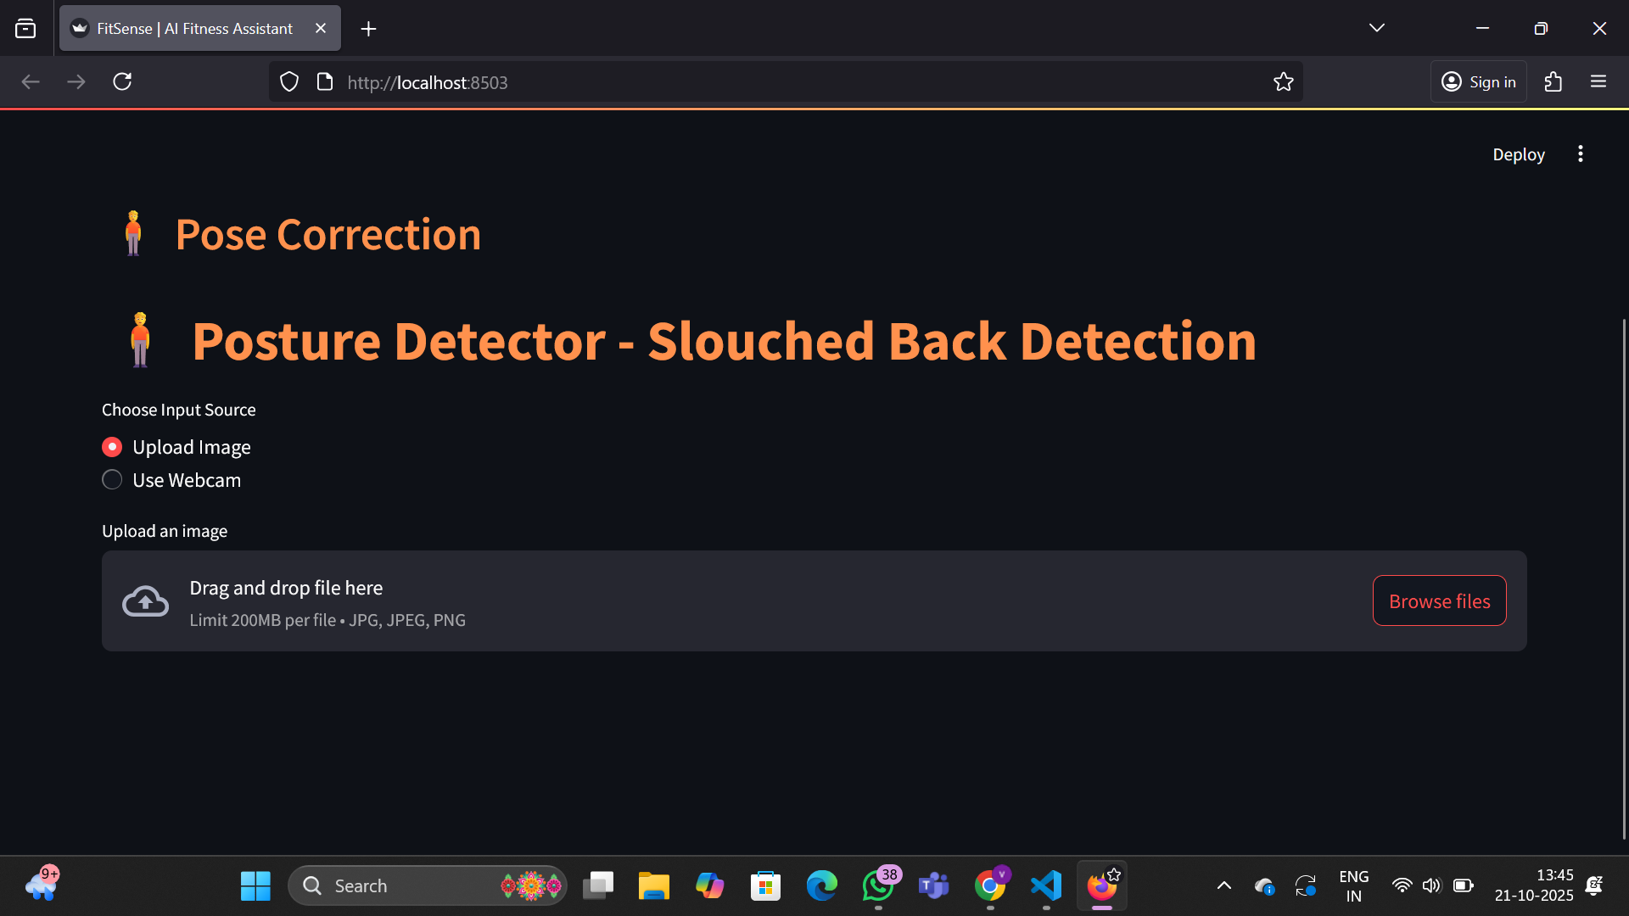
Posture detector
After uploading a image or live feed, It will detects the slouched back and gives warning beep sound with its risks. Also provides tip to correct the posture.

Slide 14
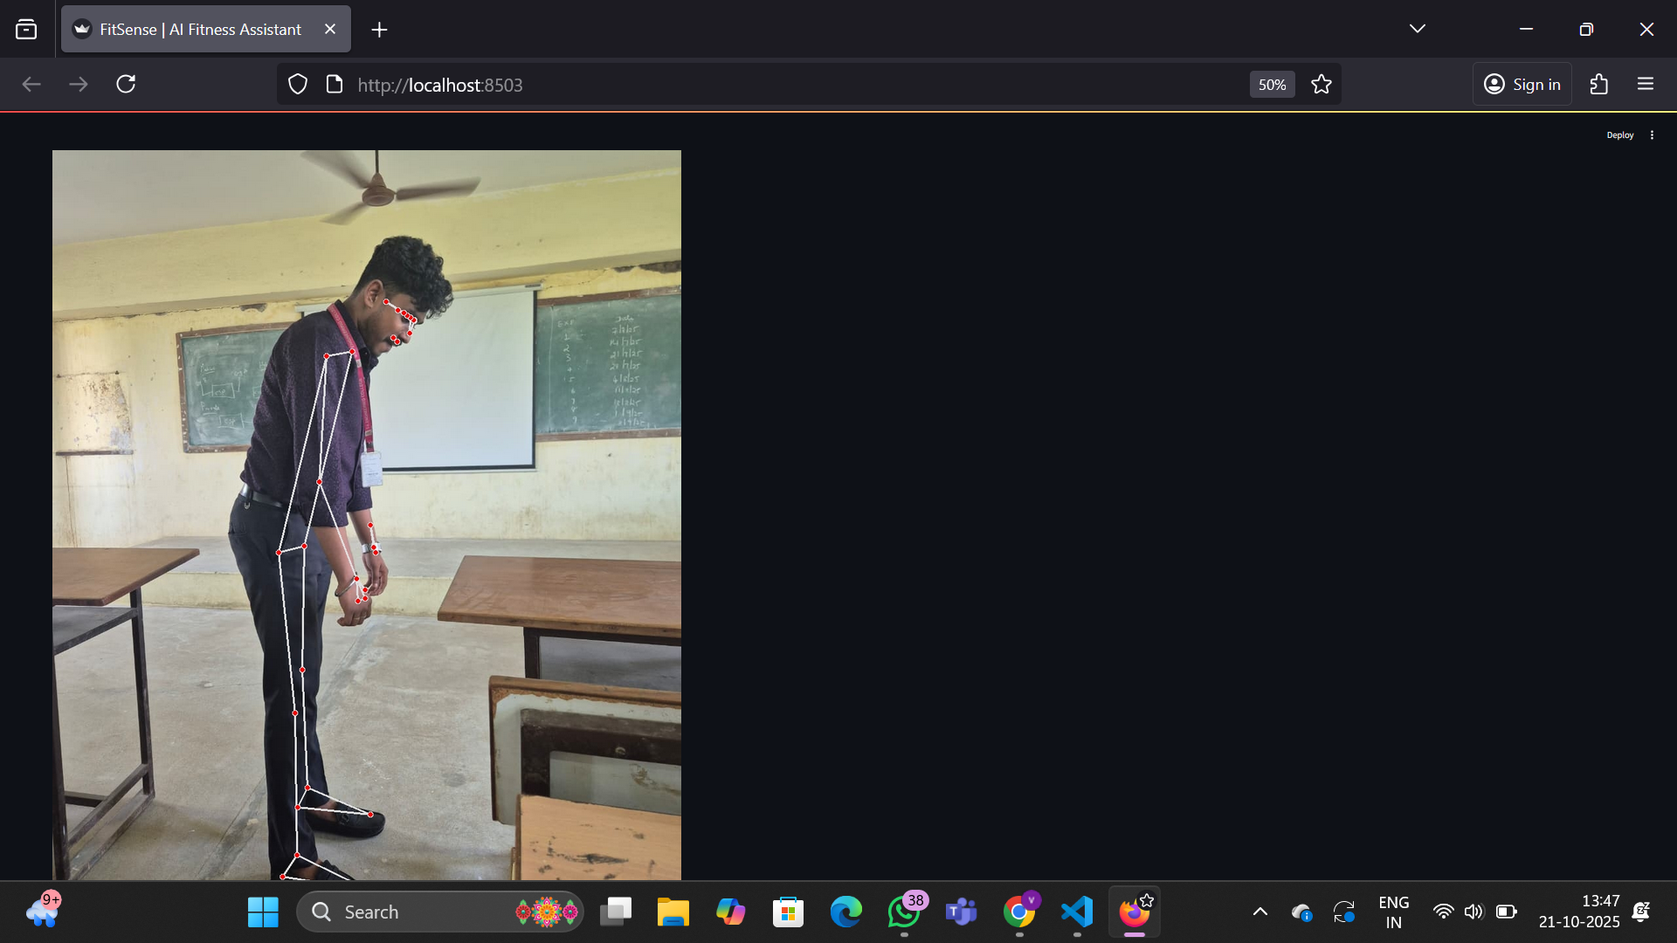
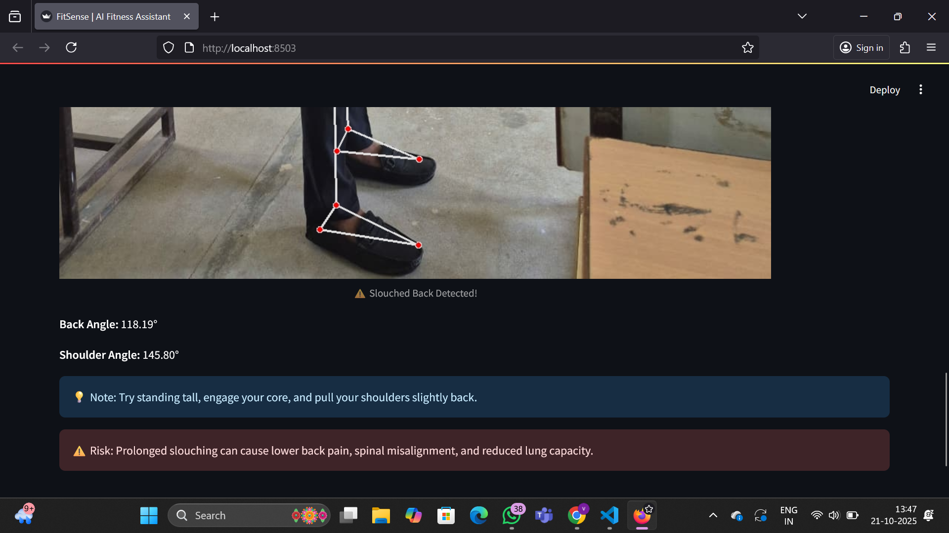

Slide 15
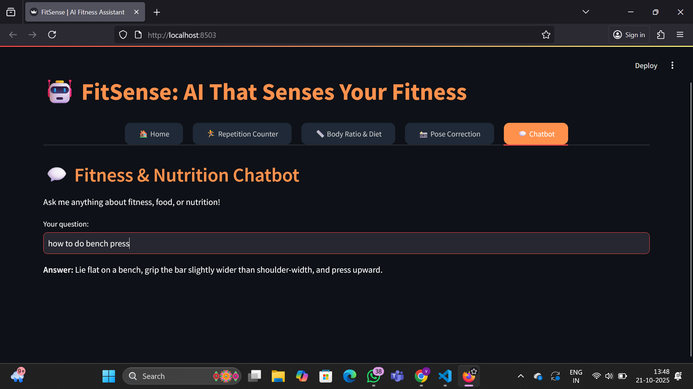
ChatBot
This will provides Answers for both fitness and nutrition related questions.

Slide 16
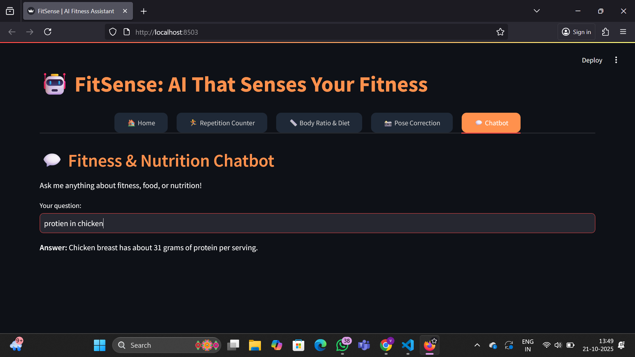
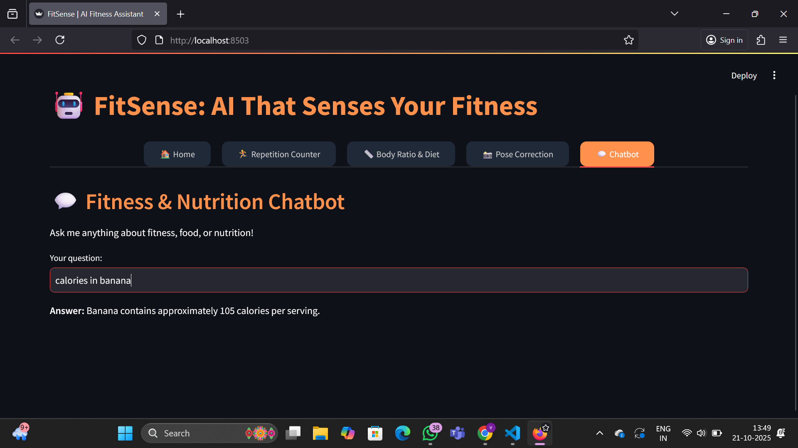

Slide 17
Roadmap
What’s Built So Far:
• Working prototype covering all 4 core modules
• Integrated chatbot, voice system, and fitness analytics
Future enhancements:
• Enhance UI/UX and optimize model performance
• Add progress tracking and voice-based training modules
Long-Term Vision: • FitSense evolves into a full-fledged AI-powered fitness ecosystem, integrating with wearables and community support.

Slide 18
Team & Roles
Name | Role | Skillset
Poojya sri | AI Developer | Computer Vision, Deep Learning
Vishal | Backend Developer | Python, Streamlit, Data Handling
Thanu | UI/UX Designer | Web Design, User Experience
Pooja | NLP Specialist | Chatbot, Language Models
Vignesh | Data Analyst | Fitness Data Insights, Model Evaluation

Slide 19
Why this team?
A well-balanced team combining expertise in AI, Computer Vision, NLP, and Data Analytics.
Members possess strong academic and technical backgrounds in AI & Data Science.
Capable of handling both technical implementation and real-world problem validation.

Slide 20
Thank You
• Contact details:
Gmail: poojyasriy@gmail.com , vishalnagarajan21@gmail.com .
Github : AI-CodeBuster
Repository link : https://github.com/AI-CodeBuster/FitSense.git

